Slide 1





Slide 2


A transaction is a unit of program execution that accesses and possibly updates various data items

Slide 3


E.g. transaction to transfer $50 from account A to account B:
1. read(A)
2. A := A – 50
write(A)
read(B)
5. B := B + 50
6. write(B)

Slide 4

Two main issues to deal with:
Failures of various kinds, such as hardware failures and system crashes
Concurrent execution of
multiple transactions

Slide 5


A Atomicity
C Consistency
To preserve the integrity of data the database system must ensure ACID properties
I Isolation
D Durability

Slide 6


Atomicity. Either all operations of the transaction are properly reflected in the database or none are.
Consistency. Execution of a transaction in isolation preserves the consistency of the database.

Slide 7


Isolation. Although multiple transactions may execute concurrently, each transaction must be unaware of other concurrently executing transactions.
Intermediate transaction results must be hidden from other concurrently executed transactions.
That is, for every pair of transactions T_{i} and T_{j}, it appears to T_{i} that either T_{j}, finished execution before T_{i} started, or T_{j} started execution after T_{i} finished.

Slide 8


Durability. After a transaction completes successfully, the changes it has made to the database persist, even if there are system failures.

Slide 9
Example of Fund Transfer
Transaction to transfer $50 from account A to account B:
1. read(A)
2. A := A – 50
write(A)
read(B)
5. B := B + 50
6. write(B)
Atomicity requirement
if the transaction fails after step 3 and before step 6,
money will be “lost” leading to an inconsistent database
state .
Failure could be due to software or hardware
the system should ensure that updates of a partially
executed transactio^{p}n^{repa}a^{red}r^{b}e^{y Vi}n^{sak}o^{h V}t^{,As}r^{sis}e^{ta}f^{nt}l^{P}e^{ro}c^{fes}t^{so}e^{r,} d in the database
LBSITW

Slide 10
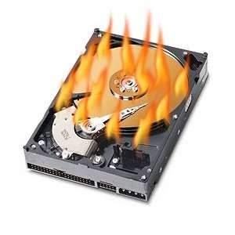
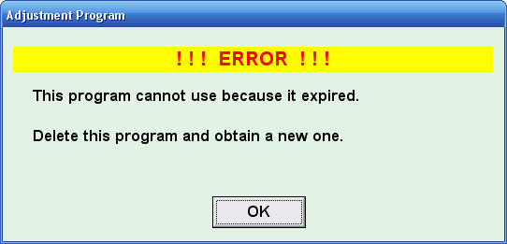
Durability requirement — once the user has been notified that the transaction has completed (i.e., the transfer of the
$50 has taken place), the updates to the database by the transaction must persist even if there are software or hardware failures.

Slide 11
Consistency requirement
the sum of A and B is unchanged by the execution of the transaction
In general, consistency requirements include
Explicitly specified integrity constraints such as
primary keys and foreign keys
Implicit integrity constraints
e.g. sum of balances of all accounts, minus sum of loan amounts must equal value of cash-in-hand
A transaction must see a consistent database.
During transaction execution the database may be temporarily inconsistent.
When the transaction completes successfully the database must be consistent
Erroneous transaction logic can lead to inconsistency

Slide 12
Isolation requirement — if between steps 3 and 6, another transaction T2 is allowed to access the partially updated database, it will see an inconsistent database (the sum A + B will be less than it should be).
T1
1. read(A)
2. A := A – 50
3. write(A)
T2
read(A), read(B), print(A+B)
4. read(B)
5. B := B + 50
6. write(B
Isolation can be ensured trivially by running transactions serially
– that is, one after the other.
However, executing multiple transactions concurrently has significant benefits, as we will see later.

Slide 13
TRANSACTION STATES
Transaction State

Slide 14
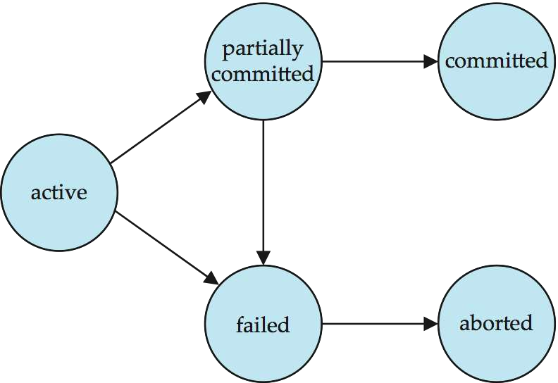

Slide 15
Active – the initial state; the transaction stays in this
state while it is executing
Partially committed – after the final statement has been executed.
Failed -- after the discovery that normal execution can no longer proceed.
Aborted – after the transaction has been rolled back and the database restored to its state prior to the start of the transaction. Two options after it has been aborted:
restart the transaction
can be done only if no internal logical error
kill the transaction
Committed – after successful completion.

Slide 16
Concurrent Executions
Multiple transactions are allowed to run concurrently in the system. Advantages are:
increased processor and disk utilization, leading to better transaction throughput
E.g. one transaction can be using the CPU while another is
reading from or writing to the disk
reduced average response time for transactions: short transactions need not wait behind long ones.
Concurrency control schemes – mechanisms to
achieve isolation
that is, to control the interaction among the concurrent transactions in order to prevent them from destroying the consistency of the database

Slide 17
Schedules
Schedule – a sequences of instructions that specify the order
in which instructions of concurrent transactions are executed
a schedule for a set of transactions must consist of all instructions of those transactions
must preserve the order in which the instructions appear in each
individual transaction.
A transaction that successfully completes its execution will have a commit instructions as the last statement
by default transaction assumed to execute commit instruction as
its last step
A transaction that fails to successfully complete its execution
will have an abort instruction as the last statement

Slide 18
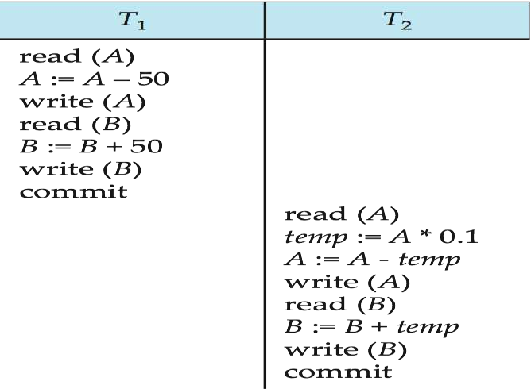
Schedule 1
Let T₁ transfer $50 from A to B, and T₂ transfer 10% of the balance from A to B.
A serial schedule in which T₁ is followed by T₂ :

Slide 19
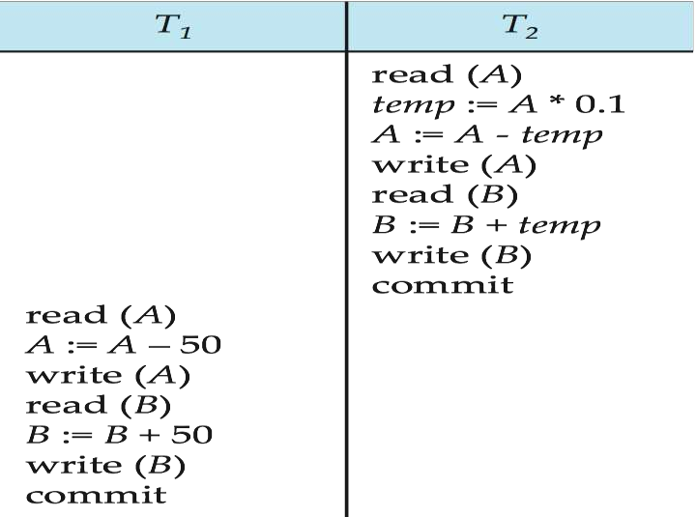
Schedule 2
A serial schedule where T₂ is followed by T₁

Slide 20
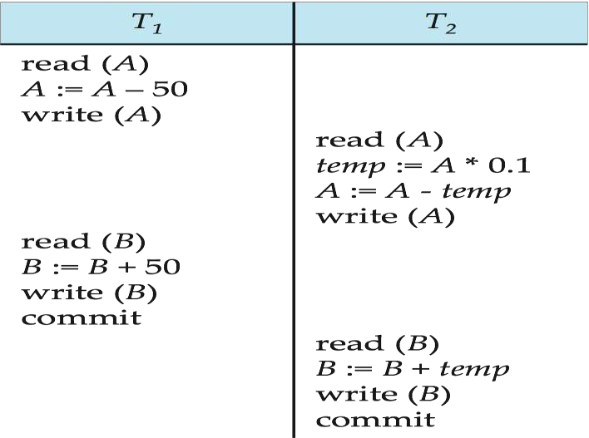
Schedule 3
Let T₁ and T₂ be the transactions defined previously. The following schedule is not a serial schedule, but it is equivalent to Schedule 1.
Concurrent schedule →
In Schedules 1, 2
and 3,
the sum A + B is
preserved.

Slide 21
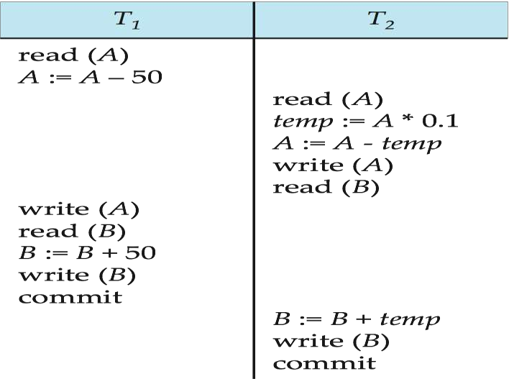
Schedule 4
The following concurrent schedule does not preserve the value of (A + B ).

Slide 22
SERIALIZABILITY OF TRANSACTION

Slide 23







Slide 24




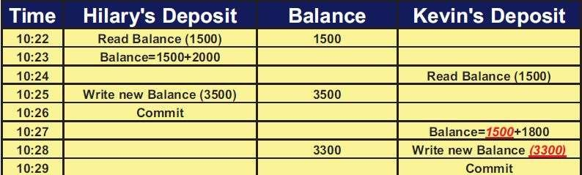
This problem occurred because two transactions are working on the same resource without knowing each other’s activity

Slide 25



: transaction reads values written by another transaction that hasn’t committed yet.
This problem has occurred because two transactions are working on the same resource without knowing
each other’s activity

Slide 26
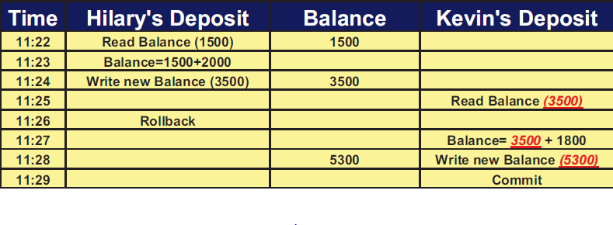

Slide 27


Newly inserted rows appear as phantom to the
transaction
A transaction re-executes a query returning a set of rows that satisfy a search condition and finds that the set of rows satisfying the condition has changed as a result of another recently committed transaction

Slide 28

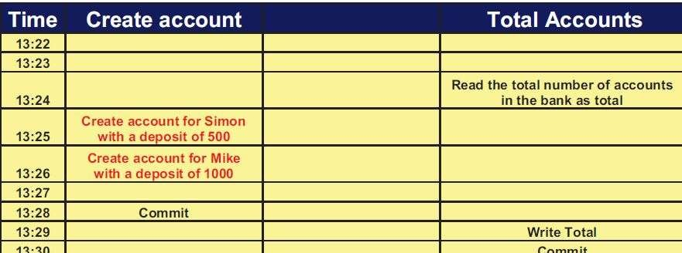

Slide 29




It is the process of finding concurrent schedule equivalent to
serial schedupreplaered by Visakh
LBSI

Slide 30

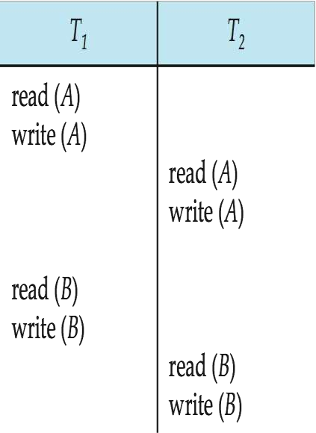
Transactions are programs.
Here we consider only two operations READ and WRITE

Slide 31




Two forms

Slide 32











i1,i2 : two consecutive instructions of different transactions

Slide 33

4 cases we need to
consider
1. l_{i}= read(Q),
l_{j} = read(Q).
l_{i} and l_{j} don’t
conflict.
2. l_{i} = read(Q), l_{j} = write(Q). They conflict.
3. l_{i} = write(Q), l_{j} = read(Q).
They conflict
4. l_{i} = write(Q), l_{j} = write(Q). They conflict

Slide 34




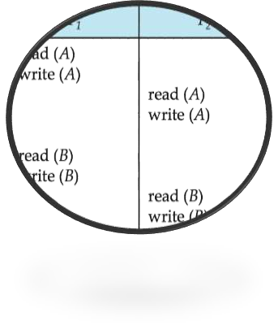
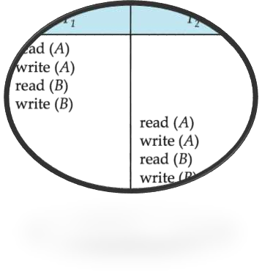
Series of swaps of non
conflict instruction

Slide 35
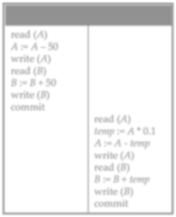
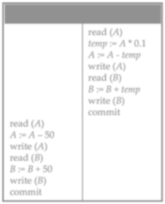


Slide 36


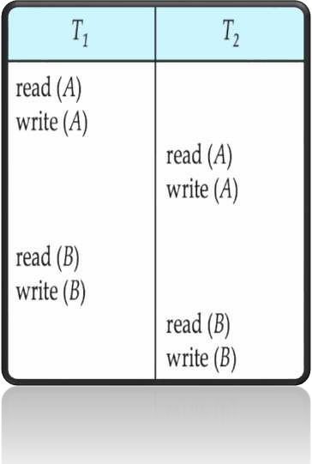
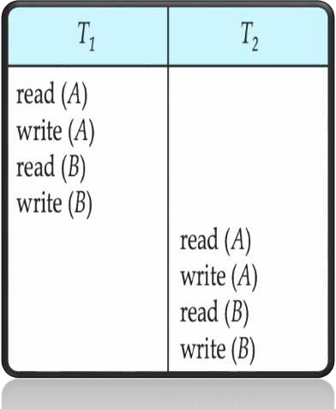

Slide 37
If S is Conflict
equivalent to a serial
schedule(here S’)
prepared by Visakh V,Assistant Professor,
LBSITW

Slide 39


It is possible to have two schedules that produce the same outcome ,but that are not conflict equivalent

Slide 40

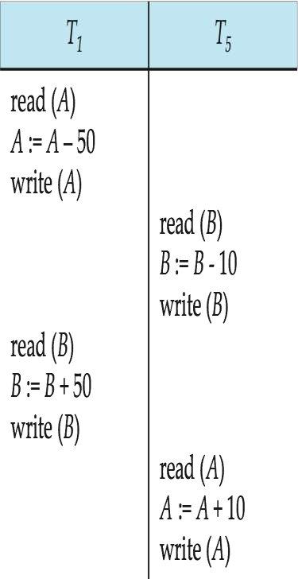
It is not conflict equivalent to its serial schedule(but
this schedule move db to a consistent state)

Slide 41

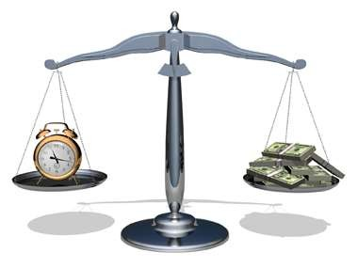
So we must consider computation performed by transactions rather than just read and write operations.
But it is hard to implement and it is computationally expensive .

Slide 42


Another schedule equivalence purely based on read
and write operations
If schedule s1 and s2 are said to be view equivalent if three conditions are met.

Slide 43


1. If T_{i} reads the initial value of object A in s1,it must
also read the initial value of A in s2.
If T_{i} read a value of A written by T_{j} in s1,it must also read the value of A written by T_{j} in s2.
For each data object A , the transaction (if any)that performs the final write on A in s1 must also perform the final write on A in s2.

Slide 44

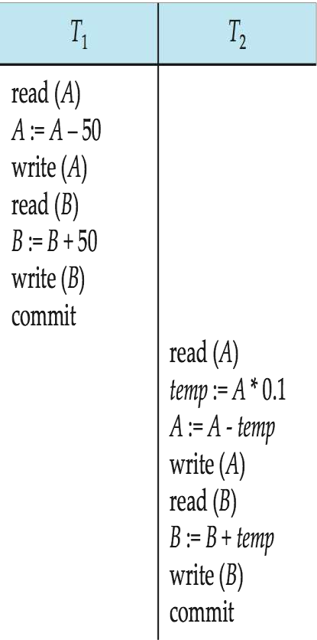
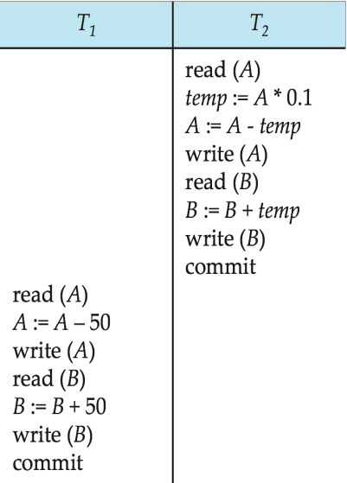

Slide 45

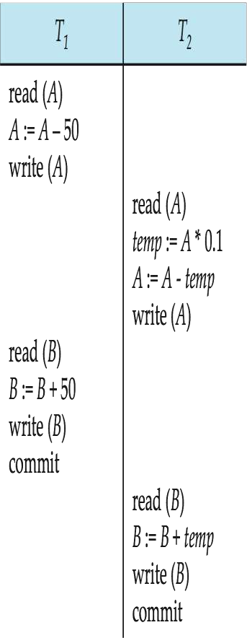

Slide 46

If S is view equivalent
to a serial
schedule(here S’)
prepared by Visakh V,Assistant Professor,
LBSITW

Slide 47
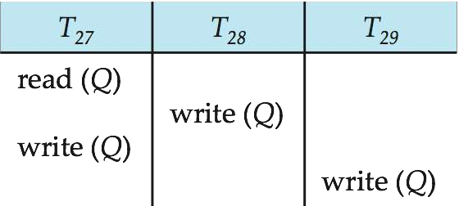
Ex: for view serializable schedule
It is view equivalent to its serial schedule

Slide 48
What is the view equivalent serial schedule
for this ?????

Slide 49
The below example is view serializable but not conflict serializable!!!

Slide 50
Every conflict serializable schedule is also view serializable, but reverse need not be true.
If blind write appear in any view serializable schedule that is not conflict serializable.
Blind write :- transaction performing write without a read operation

Slide 51



If transaction fails we need to undo the effect of this
transaction to ensure the atomicity property
Recoverable schedule
Cascadeless schedule

Slide 52


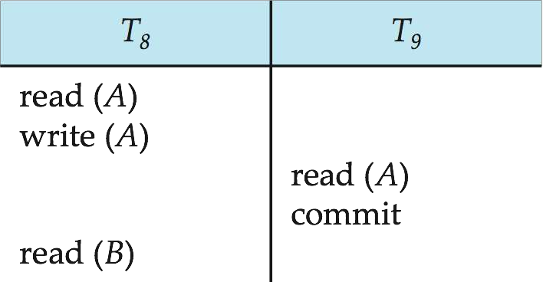
(a)Recoverable schedule
Consider the example for non recoverable schedule:
Recoverable schedule : for each pair of transaction T_{i} and T_{j} such that T_{j} reads a data item previously written by T_{i} ,the commit operation of T_{i} appears before the
commit operation of T .
j

Slide 53

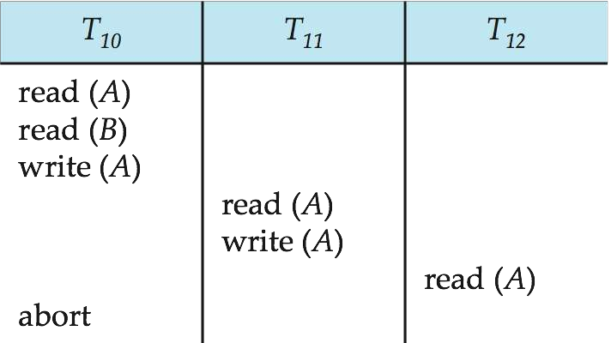




(a)cascadeless schedule
Ex: for cascading schedule
Cascading Rollback: a single transaction
failure leads to a series of transaction
prep_{r}a_{o}red_{ll}b_{b}y V_{a}isa_{c}kh_{k}V,A_{s}ssistant Professor,
LBSTW

Slide 54
Every cascadeless schedule is also recoverable

Slide 55


Isolation property may no long be preserved.
so we need Concurrency control scheme

Slide 56



Slide 57









lock is a mechanism to control concurrent access to a data item
Grants the lock to the
transaction

Slide 58






Data item can be locked in two modes
read write
read
write
prepared by Visakh V,Assistant Professor,
LBSITW

Slide 59

X-lock is requested using
lock-X instruction.
S-lock is requested using
lock-S instruction.

Slide 60










Lock –compatibility matrix
Compatible??

Slide 61

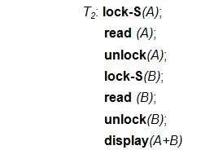
Ex: for performing locking

Slide 62
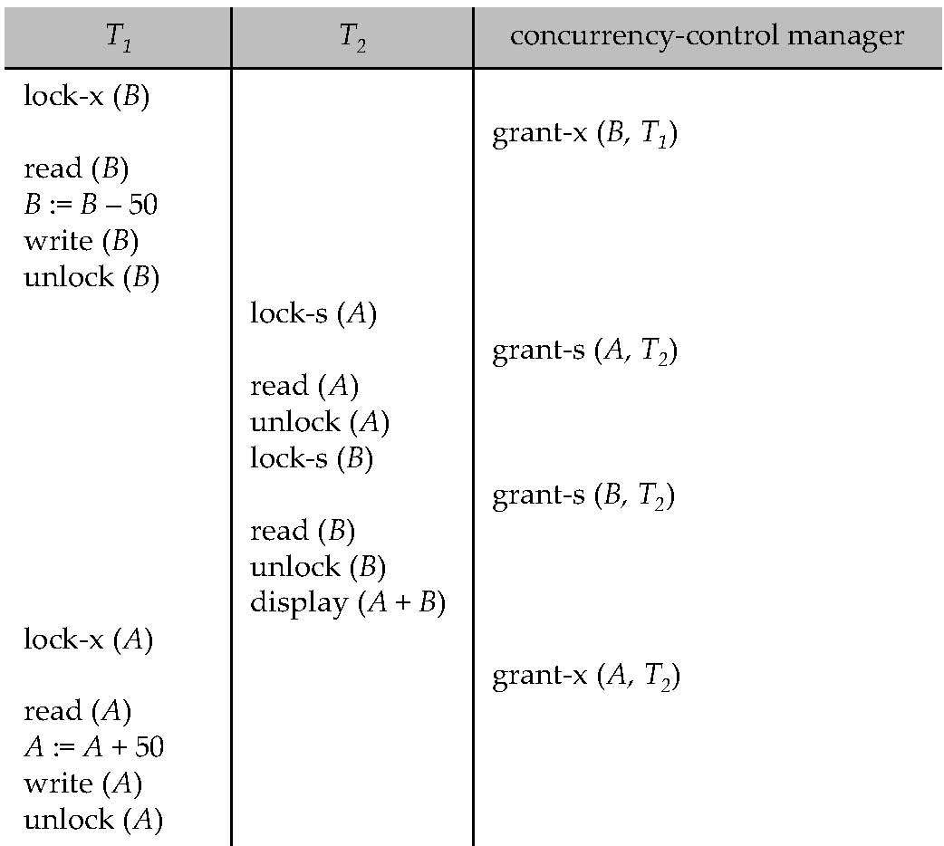


Slide 63


If a lock cannot be granted, the requesting transaction is made to wait till all incompatible locks held by other transactions have been released. The lock is then granted

Slide 64



Slide 65





Necessary condition for deadlock
A state where neither of the transaction can proceed with its normal execution

Slide 66
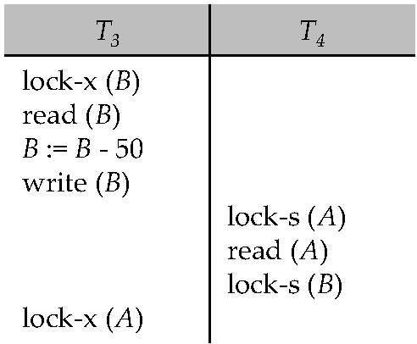
Consider the example for deadlock:

Slide 67
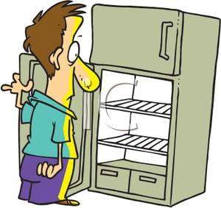

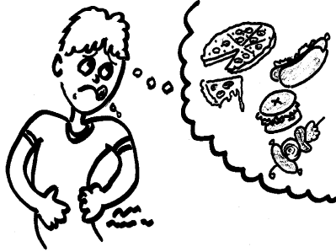

Starvation : If a transaction T never make a progress , then is said to be starved.

Slide 68
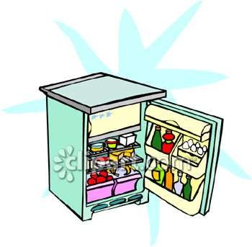

When a transaction T_{i} request a lock
on a data item Q in a particular mode M We can avoid starvation by:
There is no other transaction holding a
lock on Q in a mode that conflicts with M
There is no other transaction that is waiting for a lock on Q and that made its lock request before T_{i}

Slide 69



Set of rules
each transaction in the system follow this rule
it is for ,when a transaction may lock or unlock each of its data items.
It restricts the number possible schedules

Slide 70

A schedule s is legal under a given
locking protocol ,if s possible schedule for a set of transaction that follows the rules of the locking protocol

Slide 71
A locking protocol ensures conflict serializability if and only if all legal schedules are conflict serializable.

Slide 72

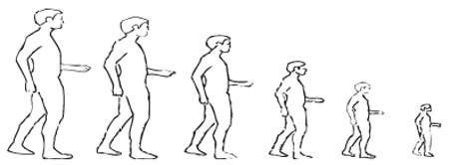
This is a protocol which ensures conflict
serializable schedules.
Phase 1: Growing Phase
transaction may obtain locks
transaction may not release locks
Phase 2: Shrinking Phase
transaction may release locks
transaction may not obtain
prepared by Visakh lVo,Ascsisktanst Professor,
LBSITW

Slide 73
Initially a
growing
transaction is in the
phase .The transaction
acquires locks as needed.
Once the transaction releases a lock ,it enters the shrinking phase and it can issue no more lock requests.
Unlock instruction do not need to appear at the end of the
transaction.
prepared by Visakh V,Assistant Professor,
LBSITW

Slide 74


lock-S(A);
read (A); unlock(A); lock-S(B);
T₁:
read (B); unlock(B); display(A+B);
T₁:
lock-s(A);
read (A);
lock-S(B);
read (B);
unlock(B);
^{u}p^{n}re^{l}pºar^{c}ed^{k}b⁽y^{B}V⁾is;akh V,Assistant Professor,
display(A+B^{LB})^{S};^{ITW}

Slide 75



The point in the schedule where
the transaction
has obtained its end of
final lock(the
growing
phase).
Two-phase locking does not ensure freedom from deadlocks

Slide 76

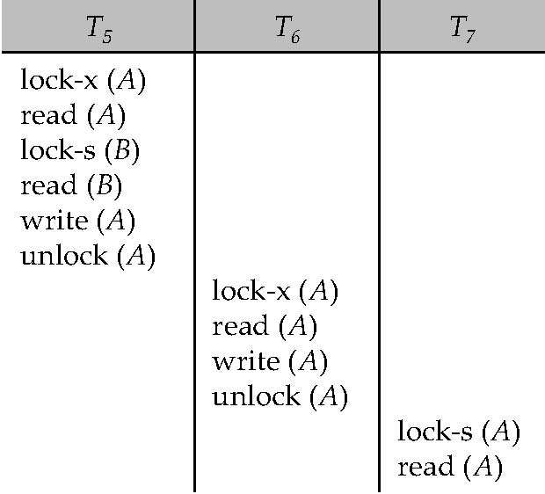
cascading rollback may occur under two phase locking

Slide 77
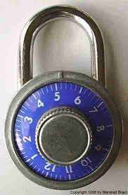

(a)Strict two phase locking
(avoiding cascading rollback )
(b)rigorous two phase locking

Slide 78
Locking be in two phase +
all exclusive mode
locks of a transaction held until the transaction commit
Locking be in two phase + all locks of a
transaction held until
prepared by Visakh V,Atsshistaent Protferssoar, nsaction commit
LBSITW

Slide 79


T1: read(A1);
read(A2);
. . . .
read(An); Write(A1)
T2: read(A1);
read(A2);
.display(A1+A2);

Slide 80

Two-phase locking with lock conversions:
First Phase:
can acquire a lock-S on item
can acquire a lock-X on item
can convert a lock-S to a lock-X (upgrade)
Second Phase:
can release a lock-S
can release a lock-X
can convert a lock-X to a lock-S (downgrade)

Slide 81



Slide 82
Another method for finding the serializability
order
The protocol manages concurrent execution such that the time-stamps determine the serializability
A time stamp is assigned by the database system before the transaction starts execution.

Slide 83





Assume transactions comes in the order T1.T2,T3
If an old transaction T_{i} has time-stamp TS(T_{i}), a new transaction T_{j} is assigned time-stamp TS(T_{j}) such that TS(T_{i}) <TS(T_{j}).

Slide 84
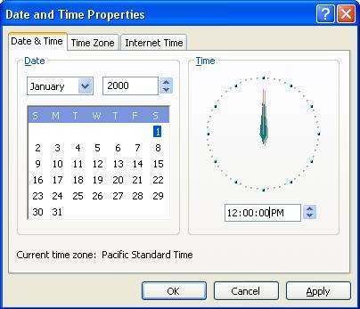


For implementing this we use two simple methods
Use the value of the system clock.
OR
Use a logical counter.

Slide 85



The time-stamps determine the serializability order , i.e. ensure that Ti appears before Tj.
maintains for each data Q two timestamp values:
.
is the largest time-stamp of any transaction that executed write(Q) successfully.
is the largest time-stamp of any transaction that executed read(Q) successfully

Slide 86
The timestamp ordering protocol ensures that any conflicting read and write operations are executed in timestamp order
The protocol operates as follows.

Slide 87


Suppose a transaction T_{i} issues a read(Q)
If TS(T_{i}) ≤ W-timestamp(Q), then T_{i} needs to read a
value of Q that was already overwritten.
Hence, the read operation is rejected, and T_{i} is rolled back.
If TS(T_{i})≥ W-timestamp(Q), then the read operation is executed, and R-timestamp(Q) is set to max(R- timestamp(Q), TS(T_{i})).

Slide 88

















READ(B)
Read rejected
Read accepted
Read rejected

Slide 89


Suppose a transaction T_{i} issues a write(Q)
If TS(T_{i}) < R-timestamp(Q), then the value of Q that T_{i} is producing was needed previously, and the system assumed that that value would never be produced.
Hence, the write operation is rejected, and T_{i} is rolled back.
If TS(T_{i}) < W-timestamp(Q), then T_{i} is attempting to write
an obsolete value of Q.
Hence, this write operation is rejected, and T_{i} is rolled back.
Otherwise, the write operation is executed, and W-
timestamp(Q) is spreeptaretdoby TVisSak(hTV,_{i}A)s.sistant Professor,
LBSITW

Slide 90
























WRITE(B)
write accepted
write rejected
^{w}wite rejected
rite rejected

Slide 91
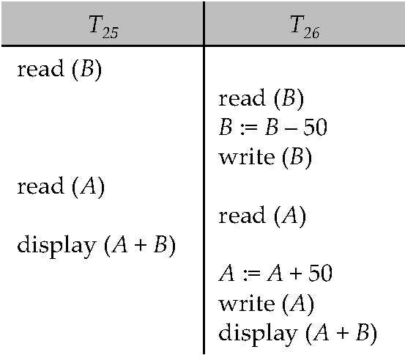
A schedule that is possible under the time stamp protocol assume TS(T25) < TS (T26)

Slide 92


ensures freedom
from deadlock
may not
cascade-free
may not
recoverable.

Slide 93

Problem with timestamp-ordering protocol:
Suppose T_{i} aborts, but T_{j} has read a data item written by T_{i ,} then T_{j} must abort; if T_{j} had been allowed to commit earlier, the schedule is not recoverable.
Further, any transaction that has read a data item written by T_{j} must abort this can lead to cascading rollback --- that is, a chain of rollbacks

Slide 94


Solution 1:
A transaction is structured such that its writes are all
performed at the end of its processing
All writes of a transaction form an atomic action; no transaction may execute while a transaction is being written
A transaction that aborts is restarted with a new timestamp
Solution 2: Limited form of locking: wait for data to be committed before reading it
Solution 3: Use commit dependencies to ensure
recoverability

Slide 95

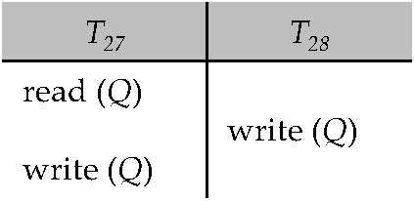
Consider the example Example :
Don’t worry, We have a soloution THOMAS WRITE RULE

Slide 96





Modified version of the timestamp-ordering protocol in which obsolete write operations may be ignored under certain circumstances.
When T_{i} attempts to write data item Q, if TS(T_{i}) < W- timestamp(Q), then T_{i} is attempting to write an obsolete value of {Q}.
– Rather than rolling back T_{i} as the timestamp ordering protocol would have done, this {write} operation can be ignored.

Slide 97
If TS(Ti)< R-timestamp(q), then the value of Q that Ti is Producing was previously needed, and it had been assumed that the value would never be produced. Hence the system rejects the write operation and rolls Ti back
If Ts(Ti) <w-time stamp(Q), then Ti is attempting to write an absolute value of Q. hence, this write operation can be ignored.
Otherwise, the system executes the write operation and sets W-timestamp(Q) to Ts(Ti)
The Difference between timestamp ordering process and Thomas write rule lies in the second rule:
In timestamp ordering protocol, if Ti issues write(Q) and Ts(Ti)< w-time stamp(q), Ti is rolled back
However in Thomas Write rule if Ts(Ti)< W timestamp(Q) and Ts(Ti)>=R-timestamp(Q) the write(Q) operation can be ignored.

Slide 98




Otherwise this protocol is the same as the timestamp ordering protocol.
Thomas' Write Rule allows greater potential concurrency.
– Allows some view-serializable schedules that are not conflict-serializable

Slide 99





Slide 100

Types of failure
1. Transaction failure
Logical error
: (due to internal condition) bad input, data not found, resource limit exceed.
System error
:entered an undesirable
state (ex:deadlock)

Slide 101
2. System crash
: h/w malfunction , or a bug in the database
s/w or OS
: loss of content in volatile
3. Disk failure
: head crash or failure during data
transfer operation.

Slide 102
Volatile storage:
does not survive system crashes
examples: main memory, cache memory
Nonvolatile storage:
survives system crashes
examples: disk, tape, flash memory,
non-volatile (battery backed up) RAM
but may still fail, losing data
Stable storage:
a mythical form of storage that survives all failures
approximated by maintaining multiple copies on distinct nonvolatilepmrepaereddbyiVaisakh V,Assistant Professor,
LBSITW

Slide 103





Slide 104
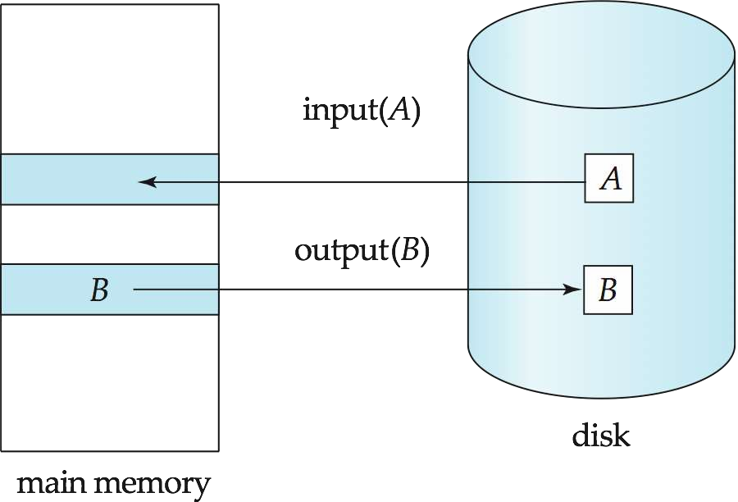



Slide 105
Blocks : Fixed length storage units
Physical blocks are those blocks residing on the disk.
Buffer blocks are the blocks residing temporarily in main memory.
Block movements between disk and main memory are initiated through the following two operations:
input(B) transfers the physical block B to main memory. output(B) transfers the buffer block B to the disk, and replaces the appropriate physical block there.

Slide 106
Example of Data Access
buffer
Buffer Block A
input(A)
A B
X
Buffer Block B
Y
output(B)
read(X)
write(Y)
x₂
x₁ y₁
work area of T₁
work area
of T₂
memory
disk

Slide 107



Transaction Log
also know as journal log / redo-log
It is a physical file
It usually contain
transaction identifier
data –item identifier(or time stamp)
old value
new value

Slide 108
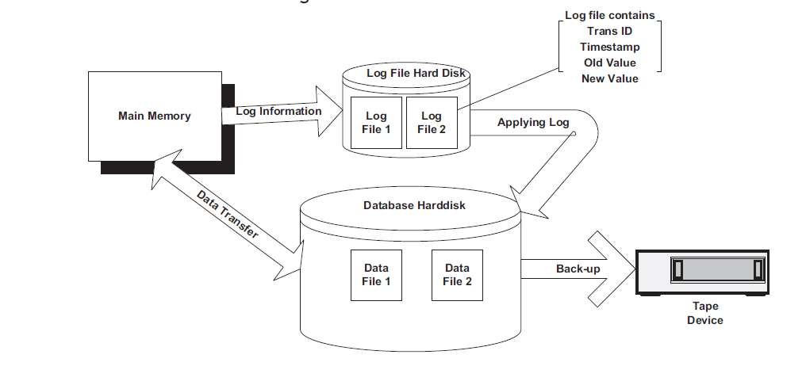

Slide 109
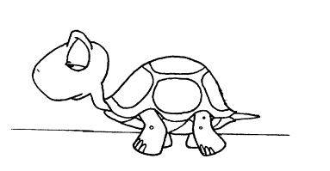







Slide 110

Also known as NO UNDO/REDO
Algorithm to support O/S, application, power, memory and machine failures
During transaction run changes recorded only in the
log files not in database
On commit changes made from
Log → database
this process is called “Re-doing”(redo(Ti)),sometimes known as ROLLFORWARD.
on rollback ,just discard the log files
on commit, just copy the log files to database

